Slide 1
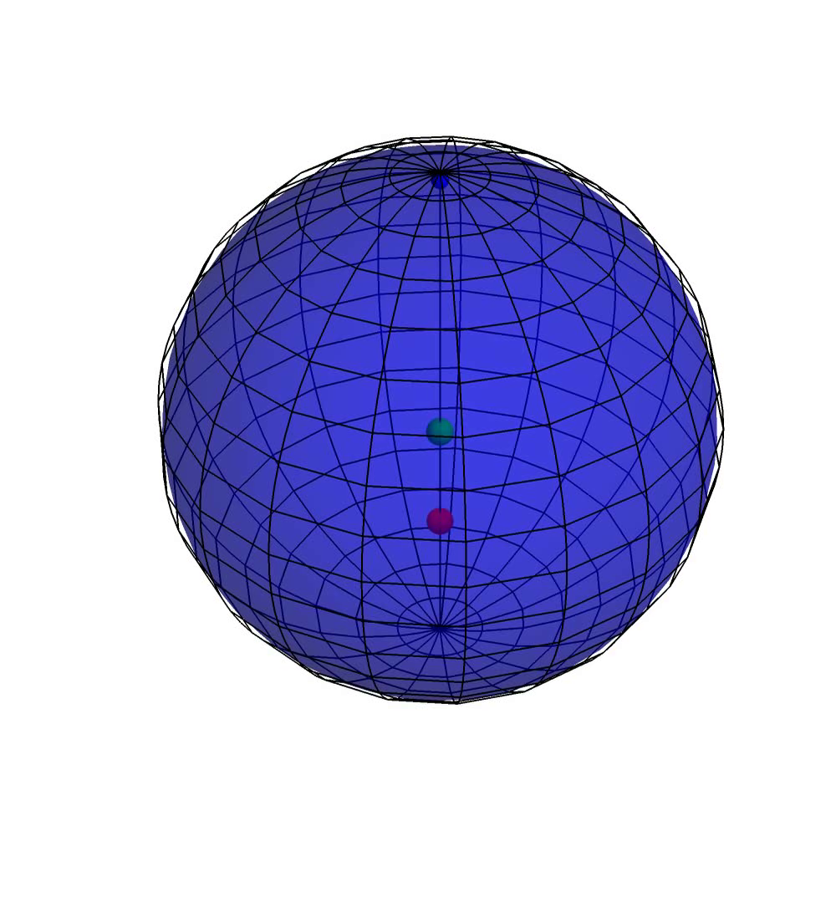
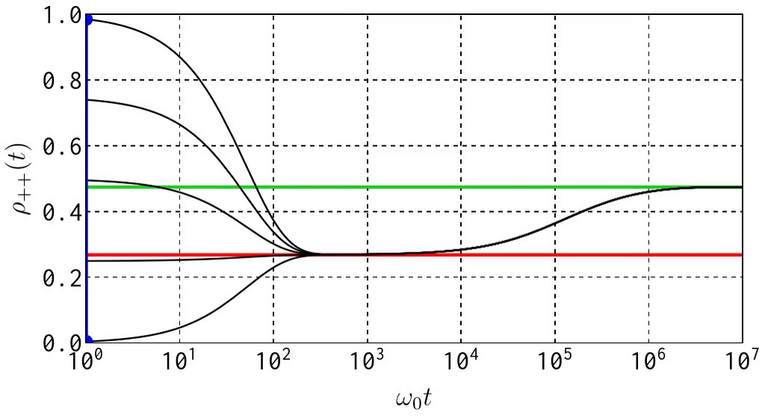
Prethermalization
S. Lorenzo, F. Plastina, M. Paternostro, Phys. Rev. A 88, 020102(R)

Slide 2
Step 1. Relaxation

Slide 3
Step 2. Prethermal

Slide 4
Step 3. Thermalization

Slide 5

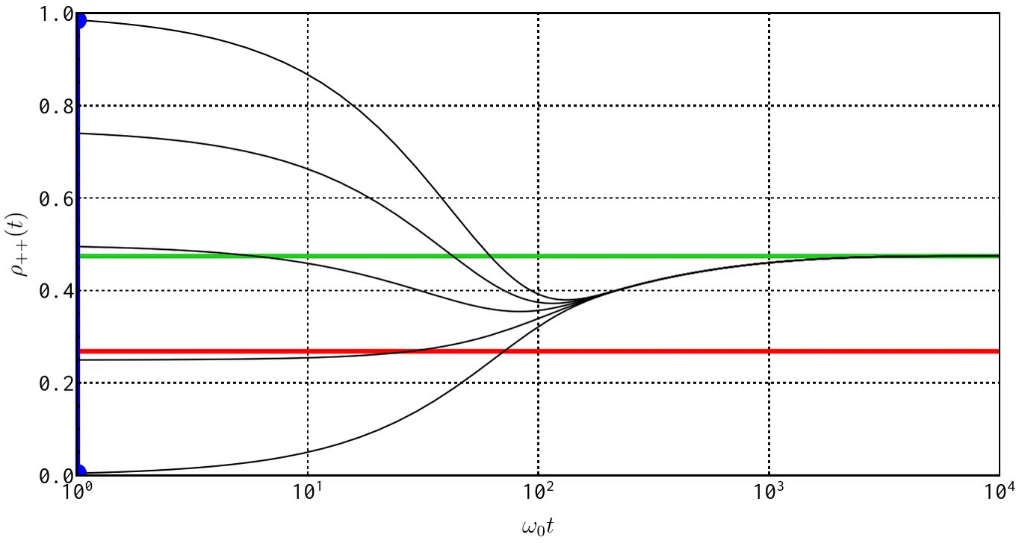
No Prethermalization

Slide 6
No Prethemalization

